Slide 1
Food Ordering Kiosk
Presented by: Rajvansh Manav
Enrollment No: 2204050200143
Email: 2204050200143@silveroakuni.ac.in
Industry: IMSCIT-B 5th Sem

Slide 2
Problem Definition
Traditional food ordering systems often face inefficiencies like long wait times, human errors, and limited customization. A self-service, automated solution can help resolve these issues and enhance the customer experience.

Slide 3
Need of Project
This project addresses the growing demand for automated food ordering solutions that reduce human intervention, improve efficiency, and enhance customer satisfaction.

Slide 4
Functional and Non-Functional Dependencies
Functional Dependencies: Menu browsing, order customization, receipt printing, and order tracking.
Non-Functional Dependencies: Performance, reliability, usability, security, and scalability.

Slide 5
Time Duration
Phase 4: Deployment and Maintenance (2 Weeks)
Install the kiosk hardware and software in a test environment
Train staff (if needed)
Monitor performance and make adjustments
Phase 1: Planning and Design (2 Weeks)
Define project scope and objectives
Gather requirements (hardware, software)
Design the system architecture and GUI layout
Phase 2: Development (3 Weeks)
Week 1-2: Set up development environment, implement basic GUI
Week 3: Integrate menu browsing and order customization features
Phase 3: Testing and Debugging (2 Weeks)
Test the system for bugs and errors
Validate functionality (menu browsing, receipt forwarding)
Conduct usability testing with real users
Total Duration: 9 weeks

Slide 6
Technology Used
Programming Language:
Python: Used for developing the kiosk’s functionality and GUI.
GUI Framework:
Tkinter: For creating an interactive, user-friendly interface.
Hardware Integration:
Touchscreen: Enables smooth user interaction.
Operating System:
Linux or Windows: Ensures application stability and compatibility.
External Libraries: Additional Python libraries for enhanced functionality.

Slide 7
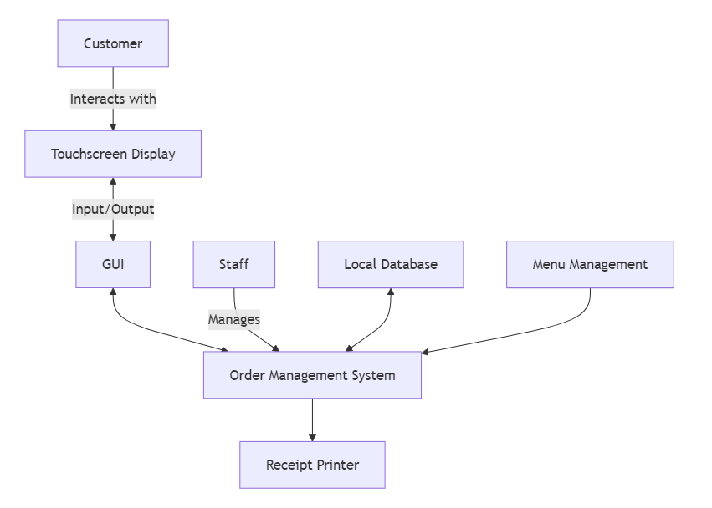
System Flow Diagram

Slide 8
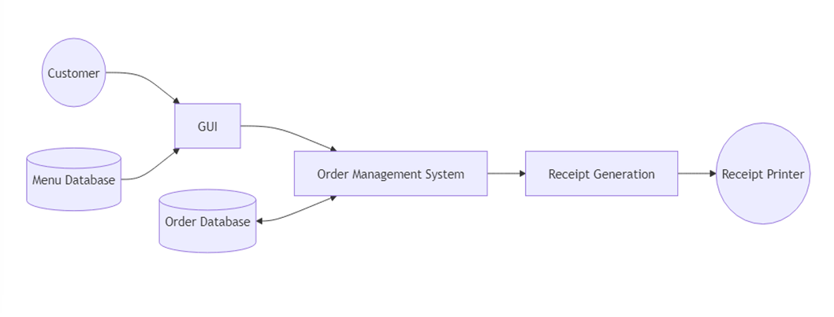
Data Flow Diagram

Slide 9
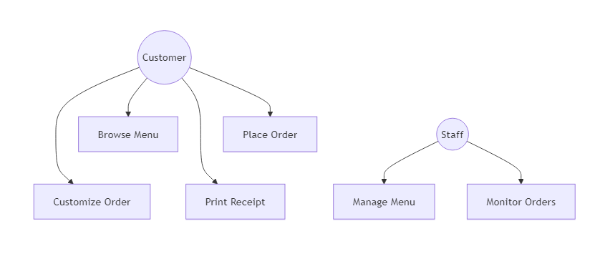
Use Case Diagram

Slide 10
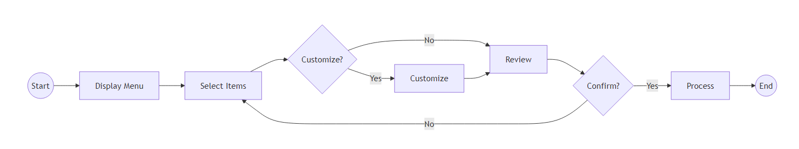
Activity Diagram

Slide 11
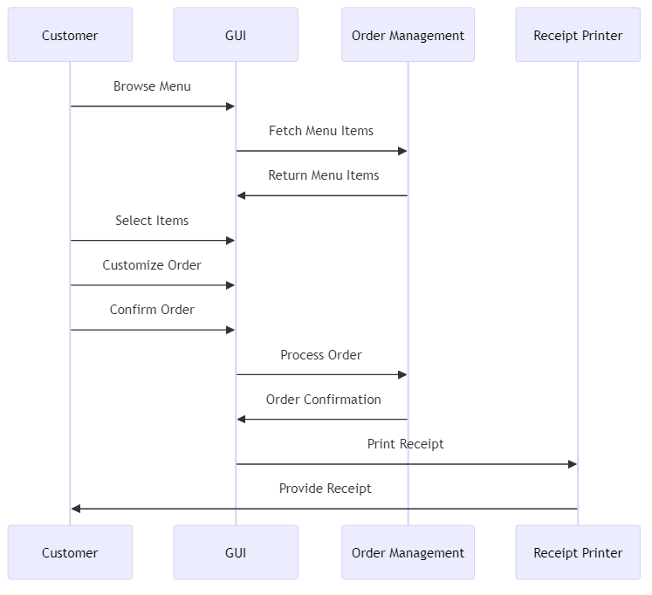
Sequence Diagram

Slide 12
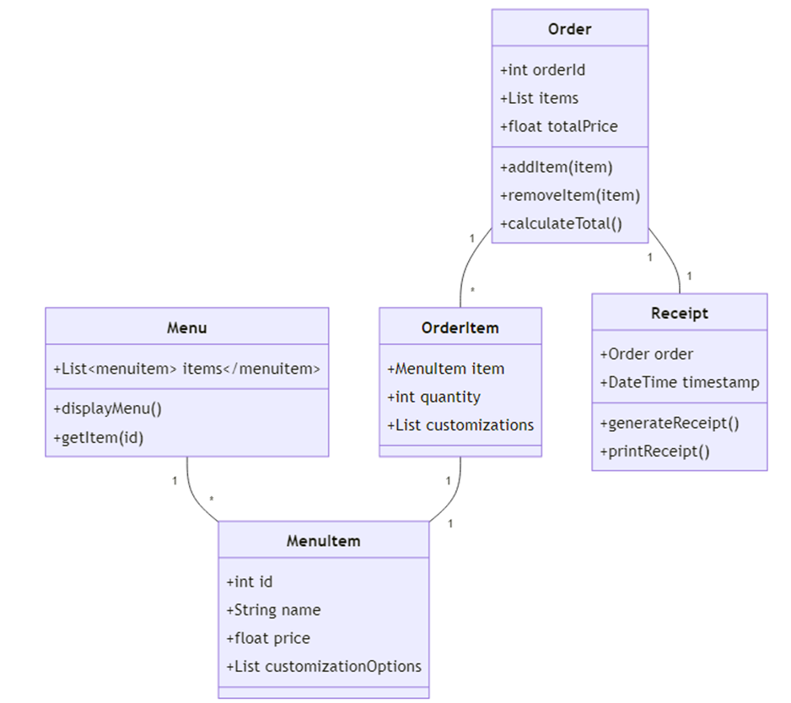
Class Diagram

Slide 13
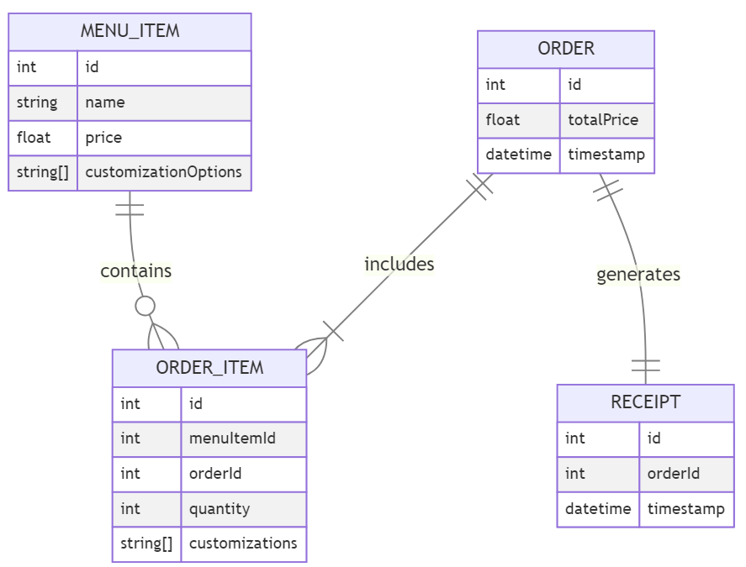
E-R Diagram

Slide 14
Application
The food ordering kiosk automates the entire ordering process, improving efficiency and reducing human error. It allows customers to browse menus, customize orders, and receive printed receipts.

Slide 15
Expected Outcomes
Faster order processing, enhanced customer experience, reduced errors, lower staffing needs, and scalability for different restaurant sizes.

Slide 16
Future Scope
Expanding customization options, multi-language support, integration with inventory systems, and potential expansion to other industries and locations.

Slide 17
References
• Tkinter Documentation https://docs.python.org/3/library/tkinter.html
• Python Official Documentation https://docs.python.org/3/
• GeeksforGeeks – Introduction to Tkinter https://www.geeksforgeeks.org/python-gui-tkinter/
• W3Schools – Python Tkinter Tutorial https://www.w3schools.in/python/gui-programming
• Stack Overflow https://stackoverflow.com For troubleshooting and community-driven solutions.
• JavaTpoint – Python Tkinter https://www.javatpoint.com/python-tkinter

Slide 18
Thank You

